Slide 1
Sentiment Analysis for Amazon Reviews
Break Through AI Team Verizon

Slide 2
TEAM MEMBERS
Sahar Sami
Cornell University
CS
2023
Palak Shah
New Jersey Institute of Technology
CS
2023
Stephanie Szpylka
CUNY Queens College
Math, Econ, CS
2023
Zhaoshu Cao
New Jersey Institute of Technology
CS, Math
2023
Notes:
Each gives own introduction

Slide 3
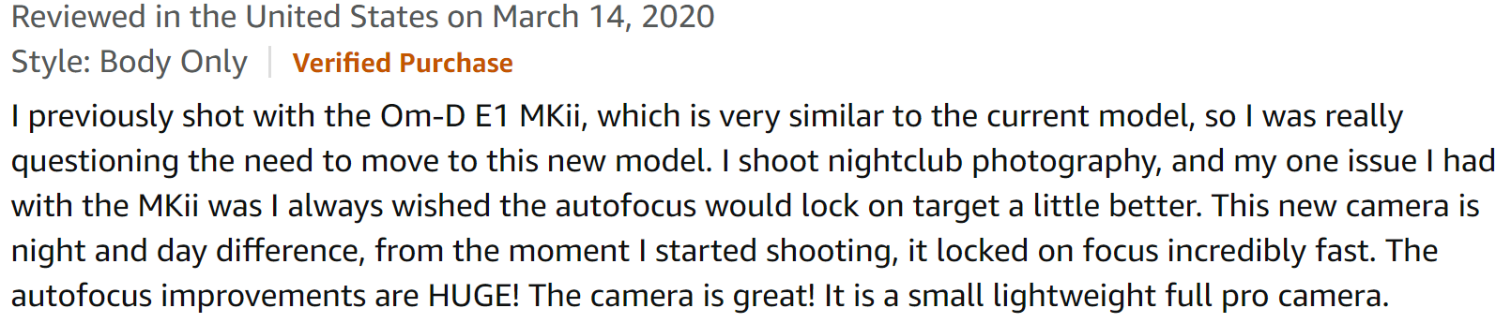
PROBLEM
In the service industry, there are hundreds of thousands of reviews without quantitative ratings. Manually combing through these reviews to identify sentiment is a time-consuming and expensive process.
Notes:
Zhaoshu

Slide 4
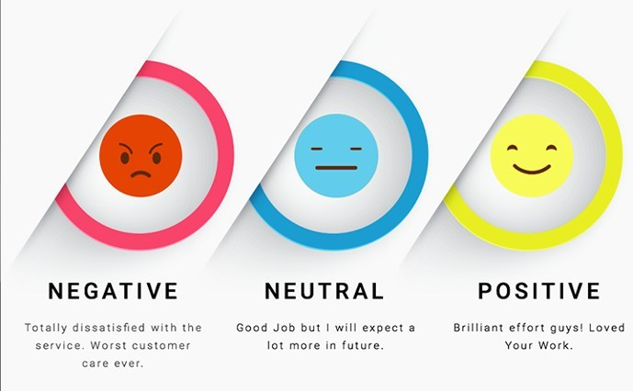
SOLUTION: Our Goal
Build a classifier to predict sentiment of reviews
Notes:
Our goal is to build a classifier that predicts the sentiment of these Amazon reviews,
where “positive” sentiment means above 4 stars,
“neutral” sentiment means 3 stars,
“negative” sentiment means 2 or fewer stars

Slide 5

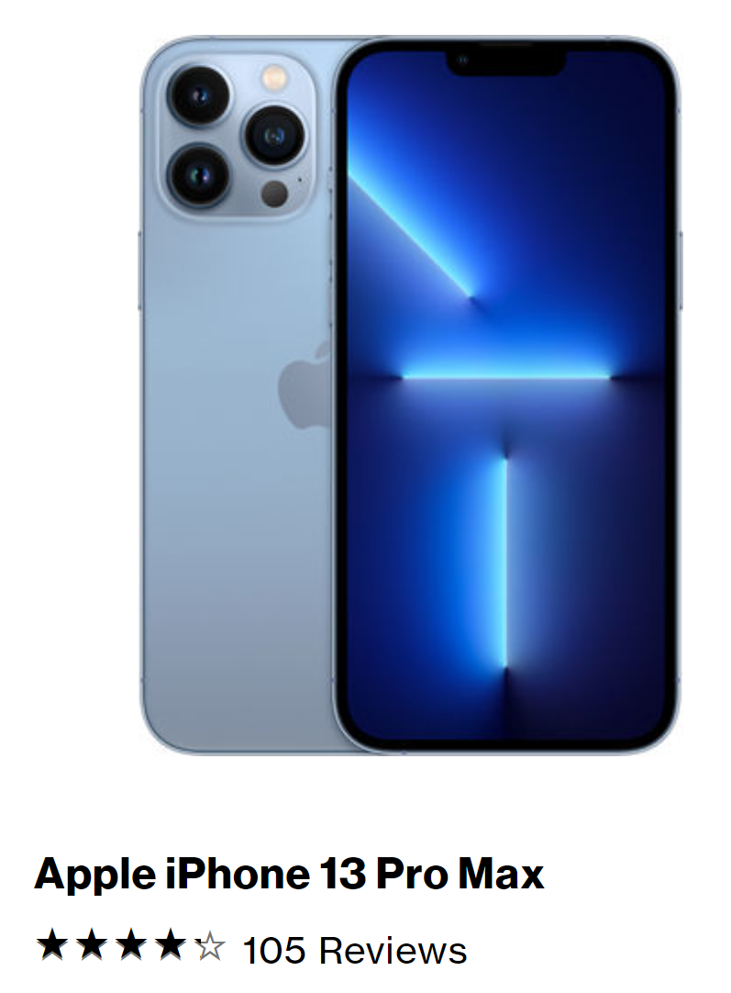
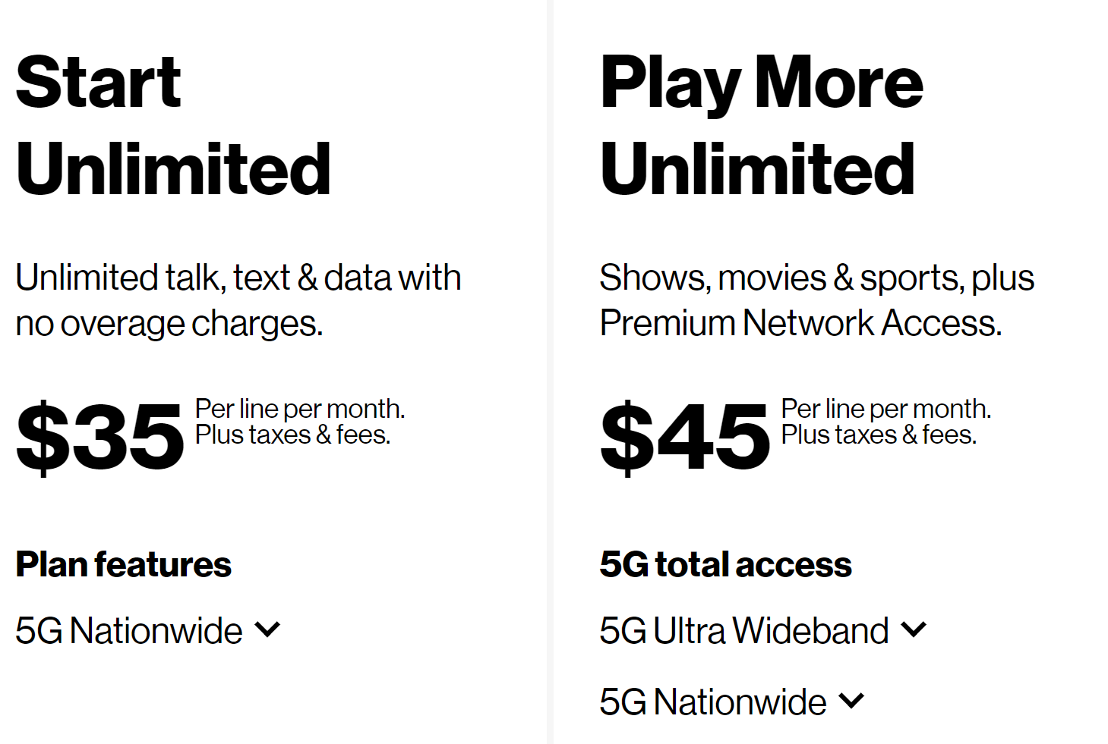
BUSINESS IMPACT
Different types of feedback for products vs. services
Quickly get quantitative feedback (sentiment value) from qualitative feedback (text) for services
Save time & money by avoiding manual analysis
Notes:
As a company that sells both products like smartphones and services like internet or mobile plans, Verizon has access to quantitative feedback for their products in the form of star ratings, but they don’t have this for services
With our model, we would be able to quickly provide categorical ratings to qualitative text reviews that can come from other channels of customer feedback, which will save them time and money
Gettings ratings from the reviews.

Slide 6
The Data

Slide 7
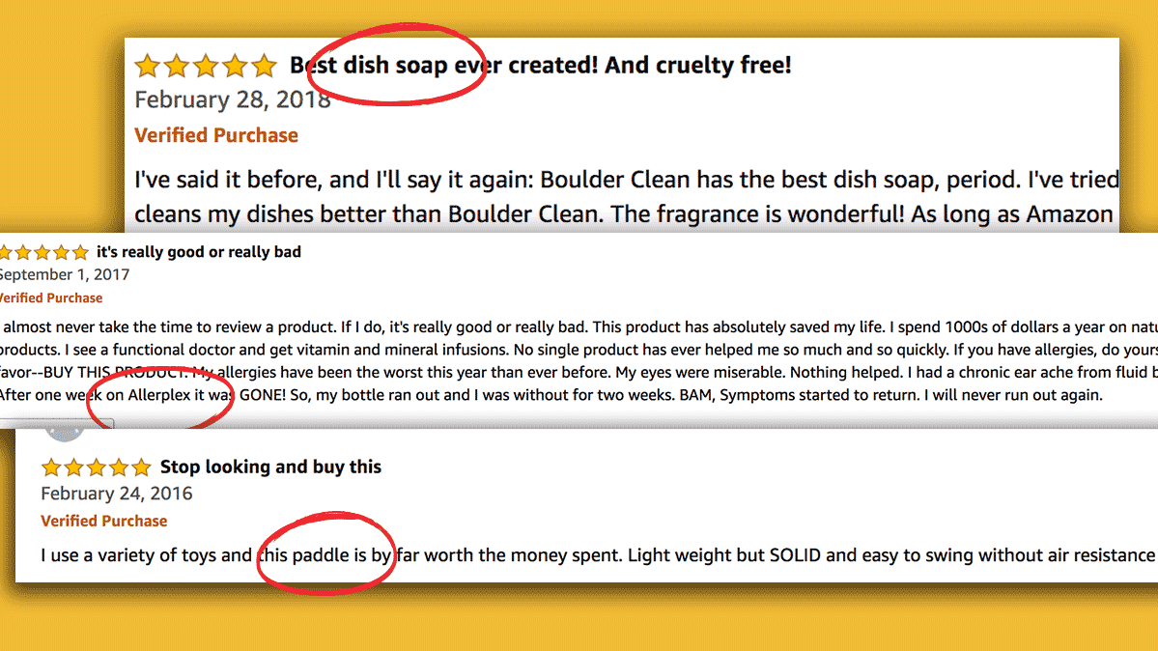
THE DATA
Over 7 million 2014 Amazon reviews for the electronics category
Key features:
Review text
Review summary
Star rating (out of 5)
Started by selecting the first 100k reviews
Notes:
We were provided an open-source dataset of Amazon reviews from 2014 across a variety of different categories.
Each review has a rating out of 5 stars.
We chose to use the electronics reviews dataset because it was the closest we could get to Verizon reviews.
This dataset contained over 7 million reviews but we decided to only use a portion of those as our dataset. The first 100K

Slide 8
DATA PREPROCESSING
Create sentiment label from star rating
4+ stars = positive (encoded as 1)
3 stars = neutral (encoded as 0)
<2 stars = negative (encoded as -1)
Change text to lowercase
Remove stopwords (while choosing some to keep)
Drop unused columns & rows with null values
Stemming and lemmatization (simplify data)

Slide 9
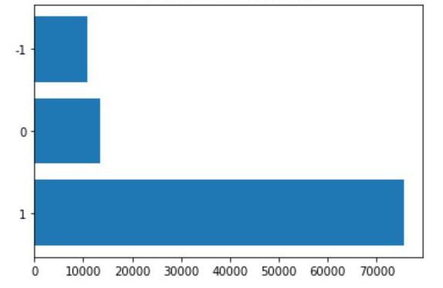
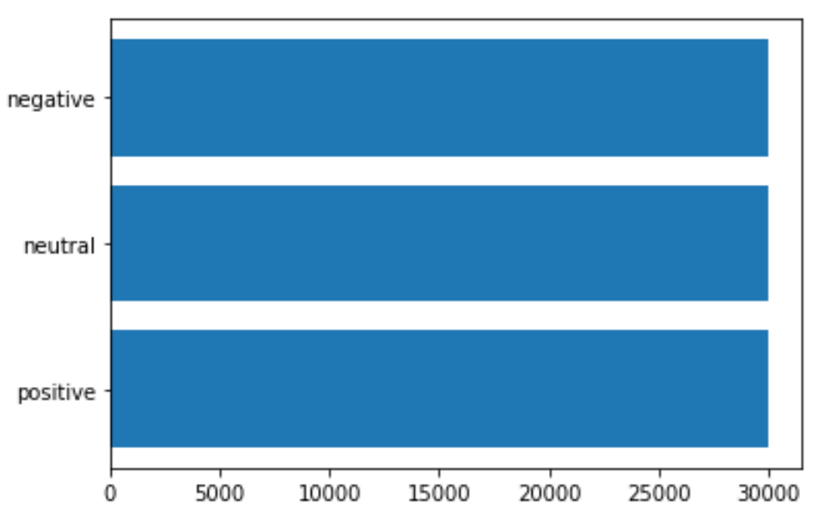
DATA SELECTION
First time selecting data: first 100k reviews
Unbalanced, skewed towards positive reviews
Second time collecting data: first 30k reviews per sentiment class
Balanced, fairer analysis
Notes:
[PALAK]
After preprocessing our data on the first 100k reviews, we calculated the number of reviews that belong to each sentiment class and saw that there were many more positive reviews than other types. We thought this would lead to problems later because our results would be skewed towards doing well for positive reviews but not negative or neutral reviews.
We then resampled the data so instead, we got the first 30k positive, negative, and neutral reviews. This way, we have balanced classes and our analysis will be more fair.

Slide 10
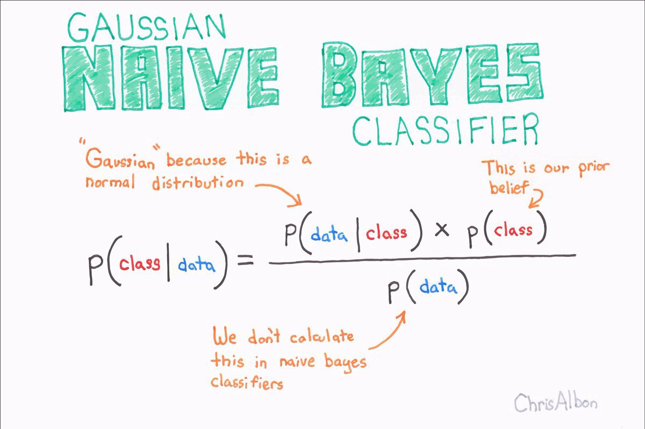
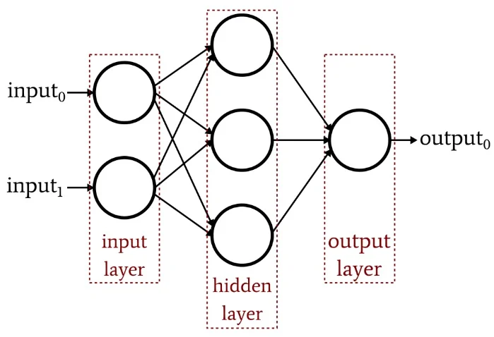
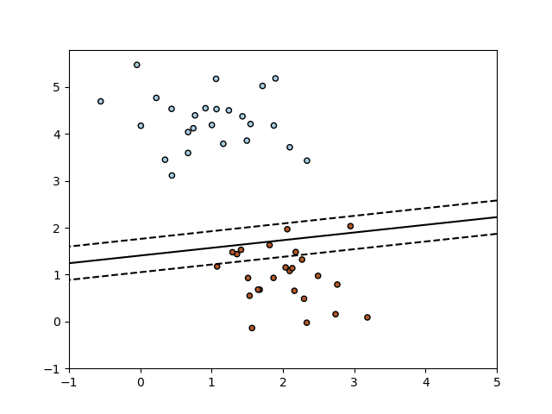
EVALUATION METHODS
Three different approaches for features
For each approach:
Feature Construction
Data Visualization
Machine Learning Models
Naive Bayes
Multilayer Perceptron (MLP)
Regularized Linear Classifier w/ SGD
Evaluating ML models by precision, recall, and accuracy

Slide 11
Approach 1: Feature Engineering with Part of Speech
Notes:
We used multiple approaches in building the classifier to find the highest accuracy possible. One of our approaches was feature engineering using parts of speech

Slide 12
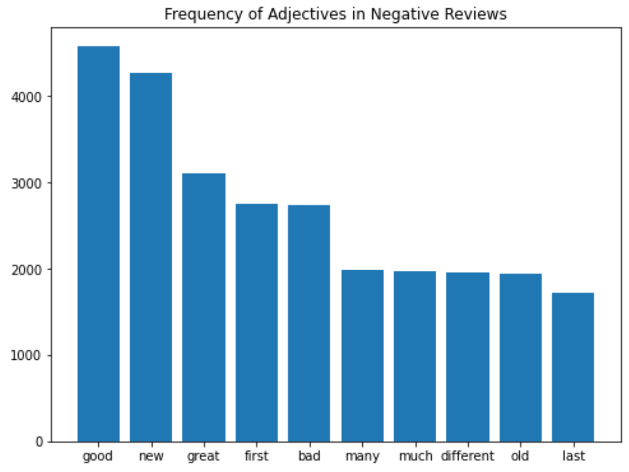
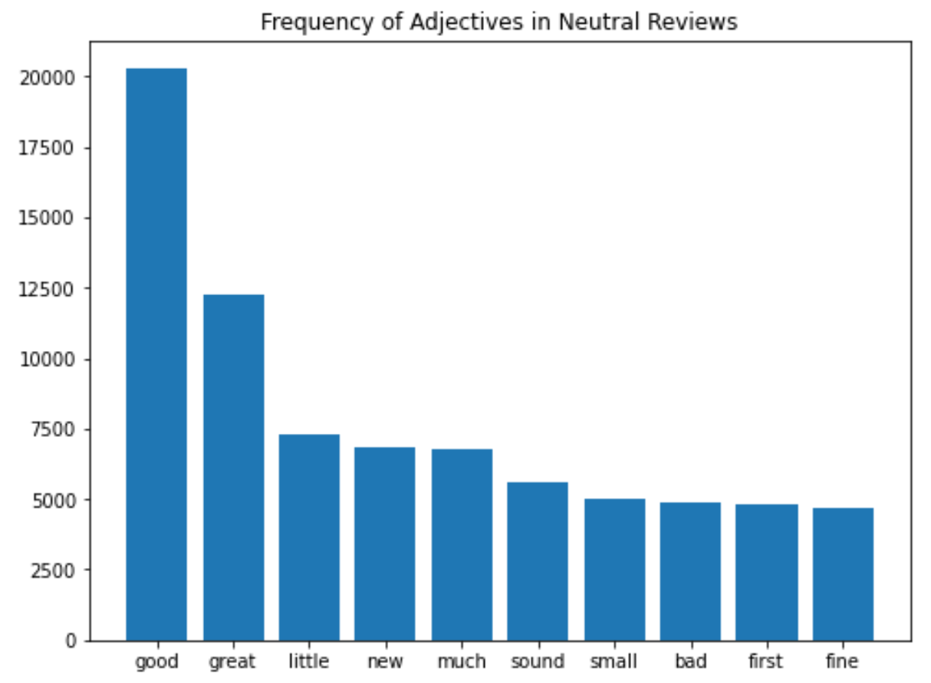
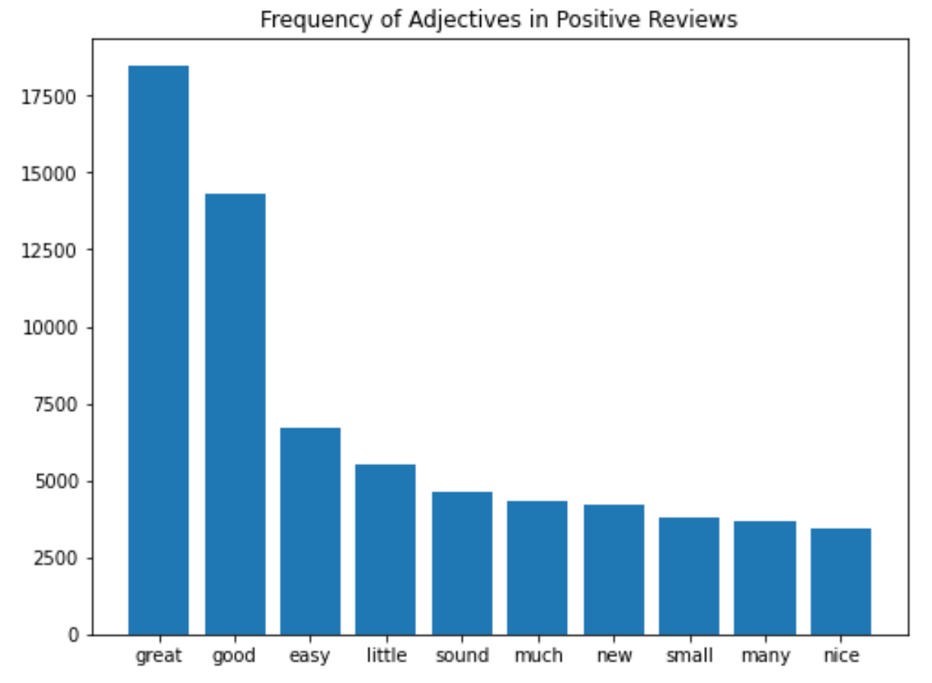
DATA ANALYSIS (POS ADJECTIVES)
Neutral Reviews
Negative Reviews
Positive Reviews
Notes:
For this approach, we decided to specifically focus on the adverbs and adjectives in the text as they are generally the main descriptors. To start with, we decided to take a look at the top 10 adverbs used in positive. Negative, and neutral reviews.

Slide 13
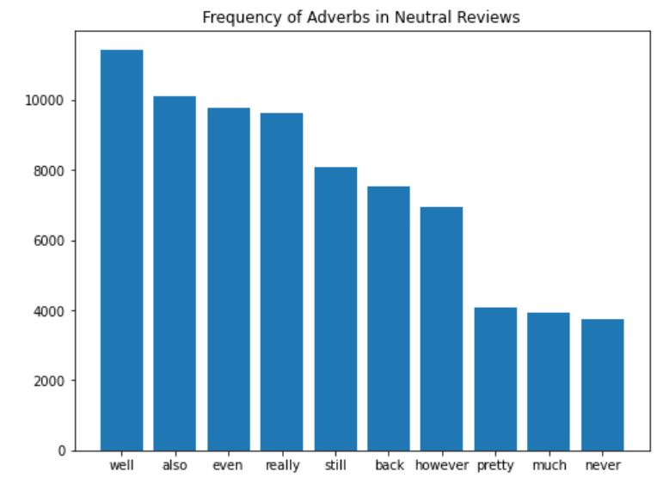
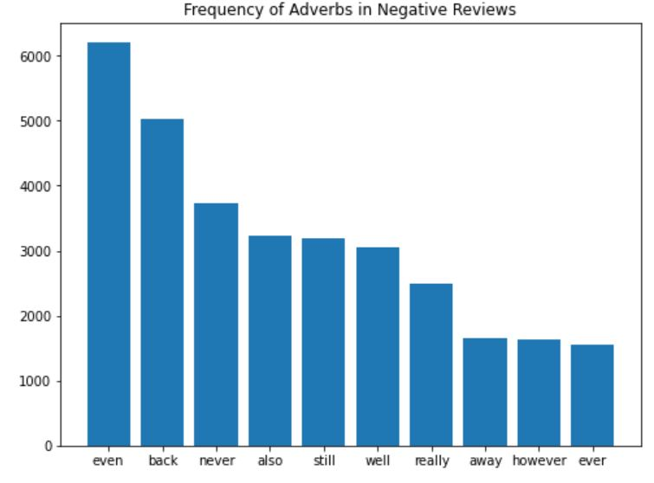
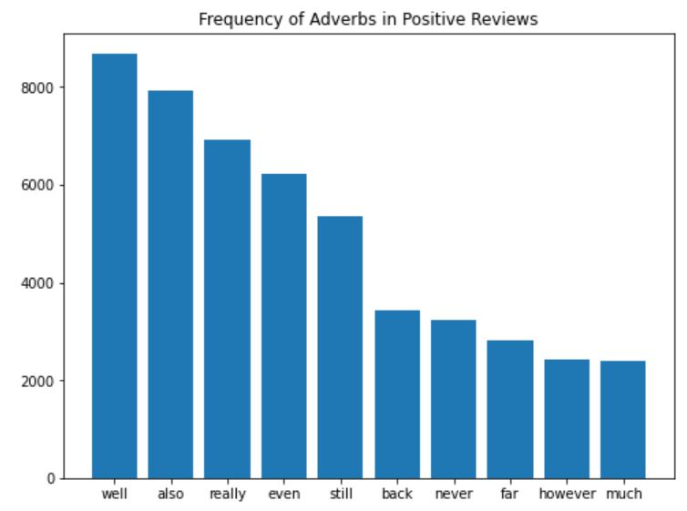
DATA ANALYSIS (POS ADVERBS)
Neutral Reviews
Negative Reviews
Positive Reviews

Slide 14
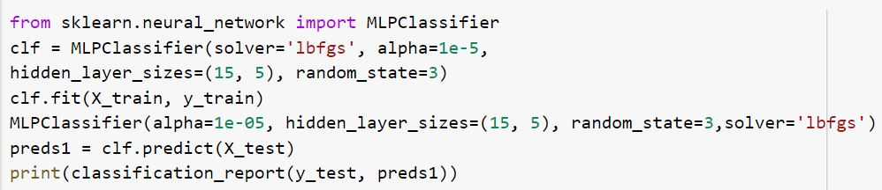
MACHINE LEARNING RESULTS
Best Model: MLP
Performance:
 | precision | recall | f1-score
negative | 0.60 | 0.46 | 0.52
neutral | 0.60 | 0.69 | 0.64
positive | 0.67 | 0.65 | 0.66
total accuracy |  |  | 0.62

Slide 15
Approach 2: Bag-of-Words

Slide 16
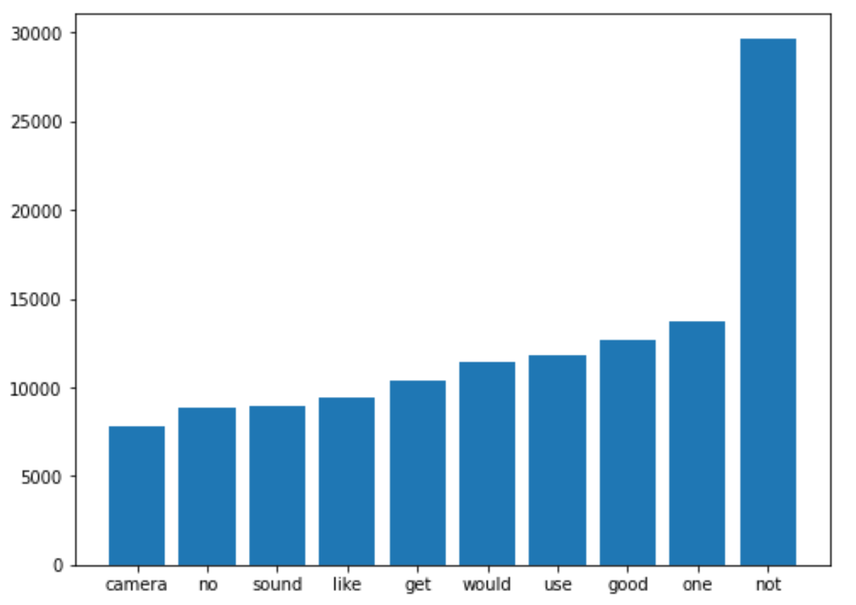
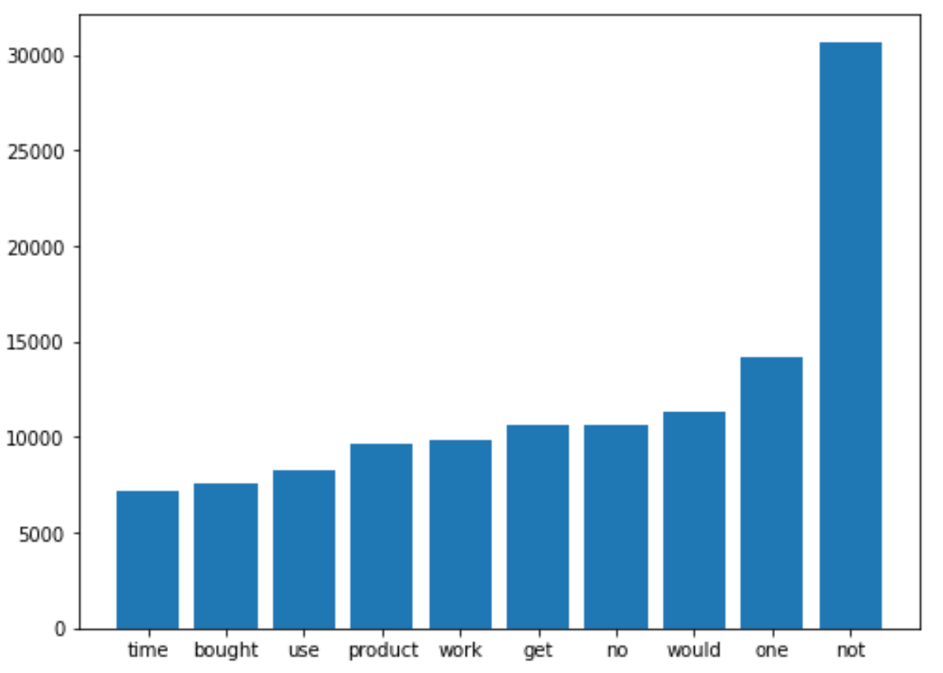
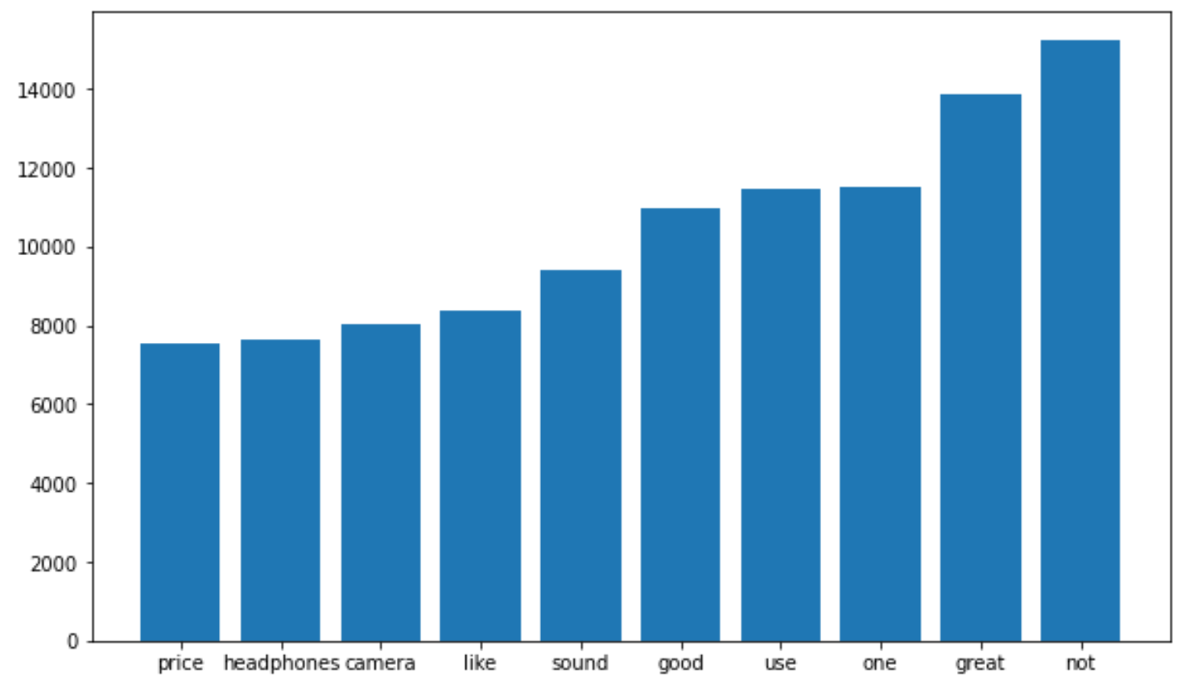
DATA ANALYSIS
Top 10 Most Frequent Words in Neutral Reviews
Top 10 Most Frequent Words in Negative Reviews
Top 10 Most Frequent Words in Positive Reviews

Slide 17
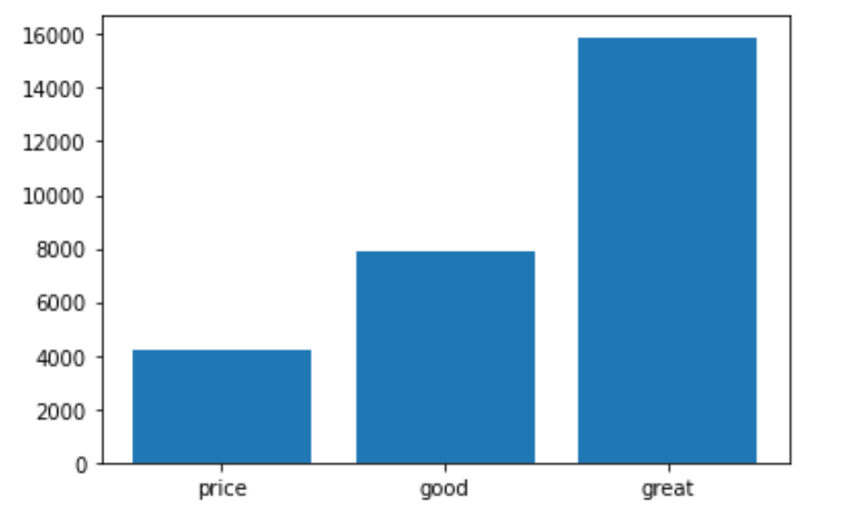
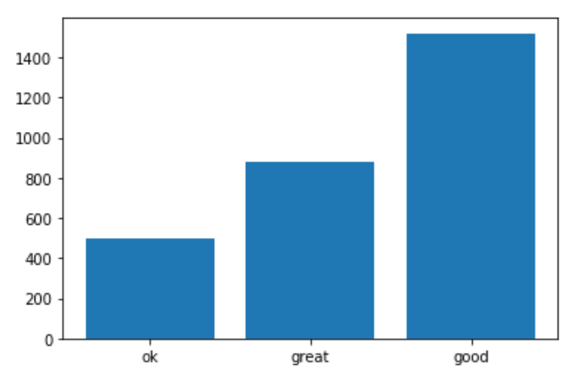
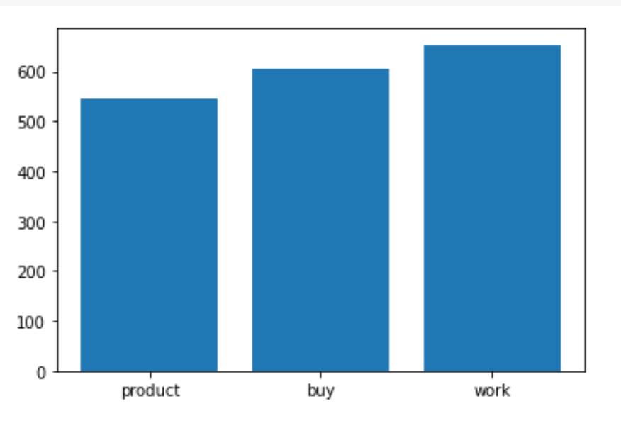
DATA ANALYSIS
Top Three Most Frequent Words in Positive Review Summaries
Top Three Most Frequent Words in Neutral Review Summaries
Top Three Most Frequent Words in Negative Review Summaries

Slide 18
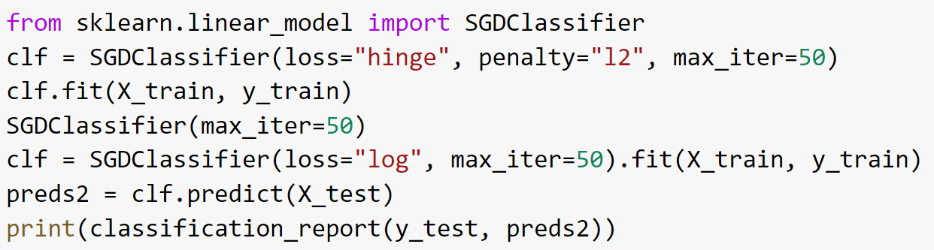
MACHINE LEARNING RESULTS
Best Model: Linear with SGD
Performance:
 | precision | recall | f1-score
negative | 0.72 | 0.65 | 0.68
neutral | 0.61 | 0.59 | 0.60
positive | 0.72 | 0.81 | 0.76
total accuracy |  |  | 0.68

Slide 19
Approach 3: Bigrams
Notes:
While we did see some good results with the bag-of-words model, we wanted to see if we could change our feature representation to something that performed well and was also intuitive so we could have some valuable insights. So we decided to change our features so that rather than getting the counts of individual words, we would get the counts of bigrams, or pairs of words.

Slide 20
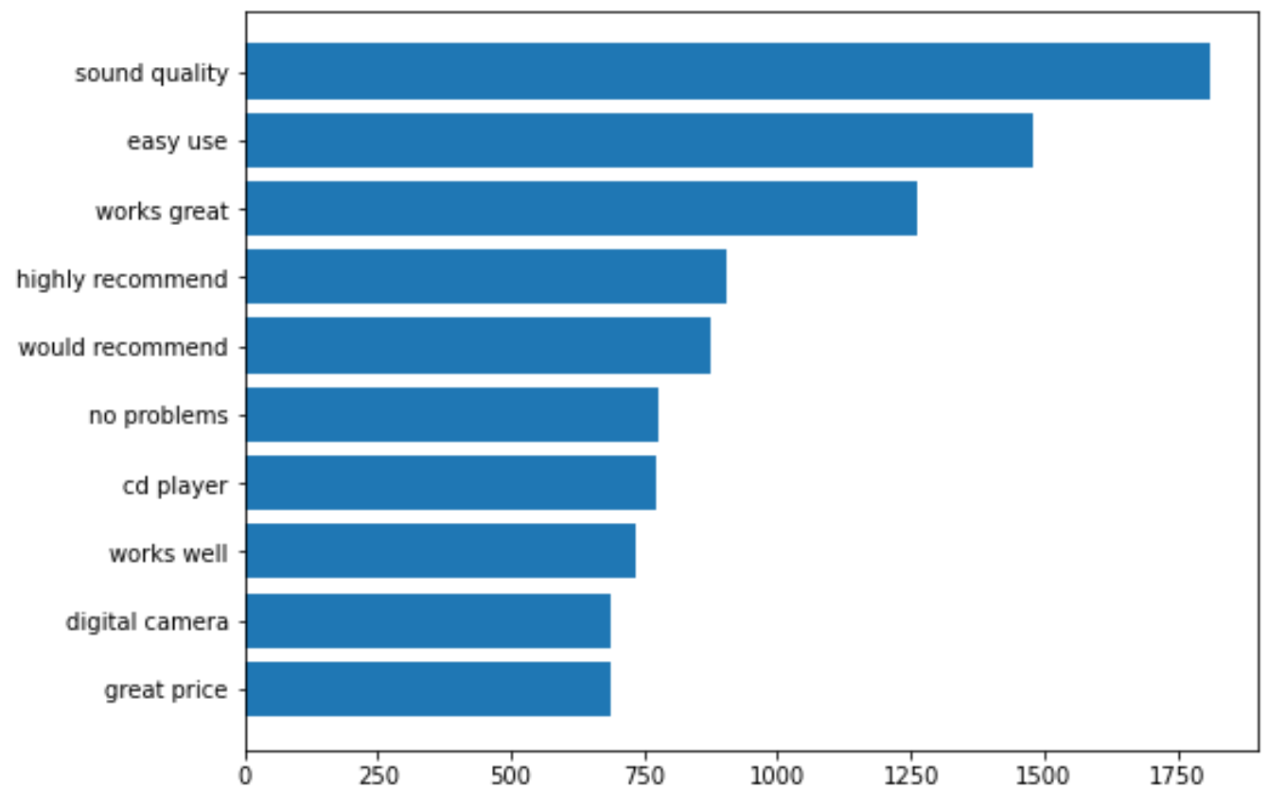
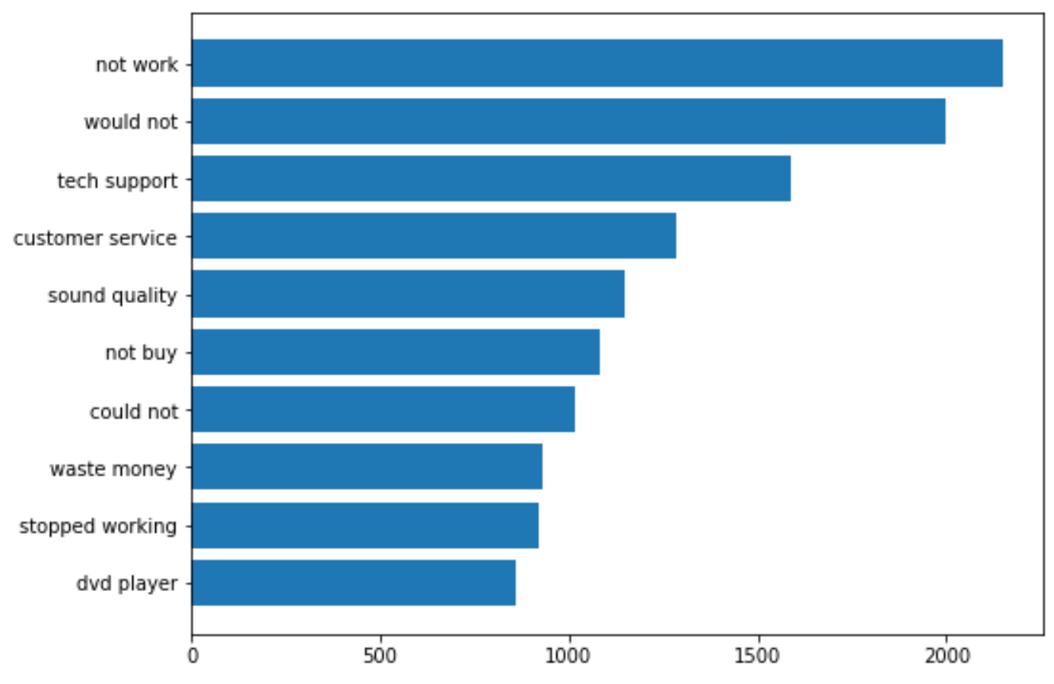
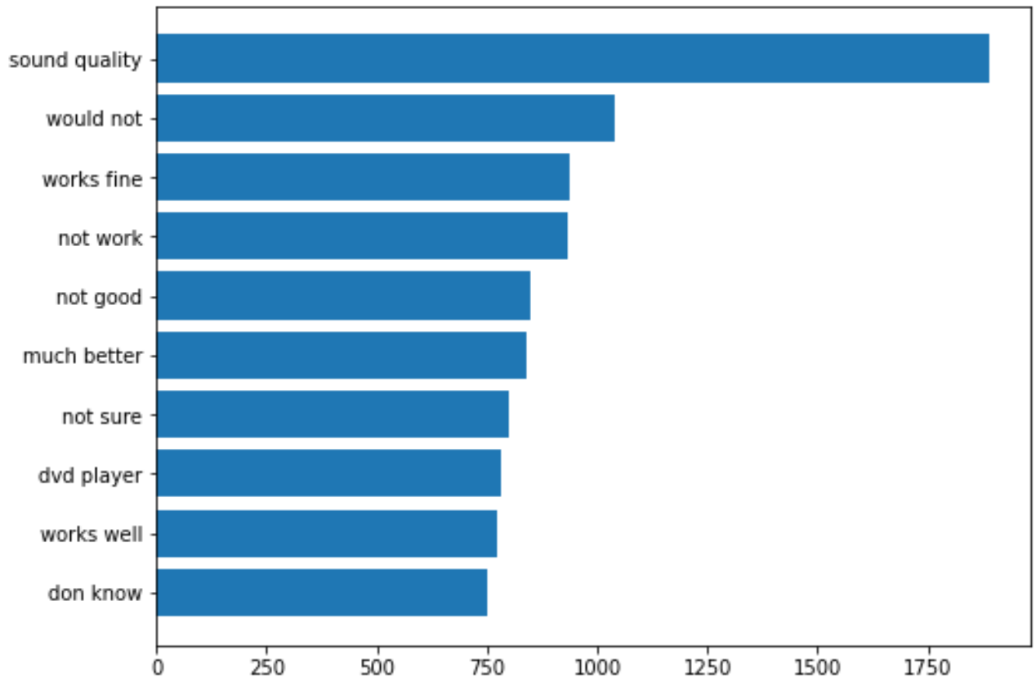
DATA ANALYSIS
Top 10 Most Frequent Bigrams in Positive Reviews
Top 10 Most Frequent Bigrams in Negative Reviews
Top 10 Most Frequent Bigrams in Neutral Reviews
Notes:
Using our same data visualization approach but with bigrams, we were able to see much larger differences between the most frequent bigrams in positive and negative reviews. The top bigrams for positive reviews are “sound quality” and “easy use”, while the top bigrams for negative reviews are not work and would not. Interestingly, the neutral reviews have a mashup of the two, with the top bigrams being “sound quality” and “would not.” Also, including the word “not” actually helped us a lot here because we can see how much it comes up in the negative review bigrams.

Slide 21
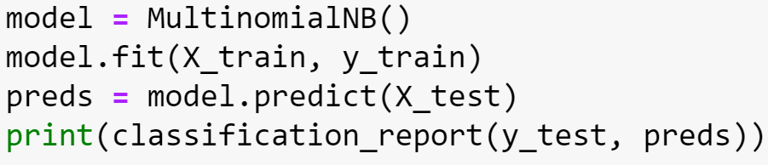
MACHINE LEARNING RESULTS
Best Model: Naive Bayes
Performance:
 | precision | recall | f1-score
negative | 0.67 | 0.72 | 0.70
neutral | 0.63 | 0.58 | 0.61
positive | 0.79 | 0.79 | 0.79
total accuracy |  |  | 0.70

Slide 22
Approach 4: Deep Learning
Notes:
Since we were a little ahead of schedule, we decided to also try and tinker with a deep learning model because with our other approaches, we were creating the features ourselves, so we wanted to see if a model could learn some features on its own.

Slide 23
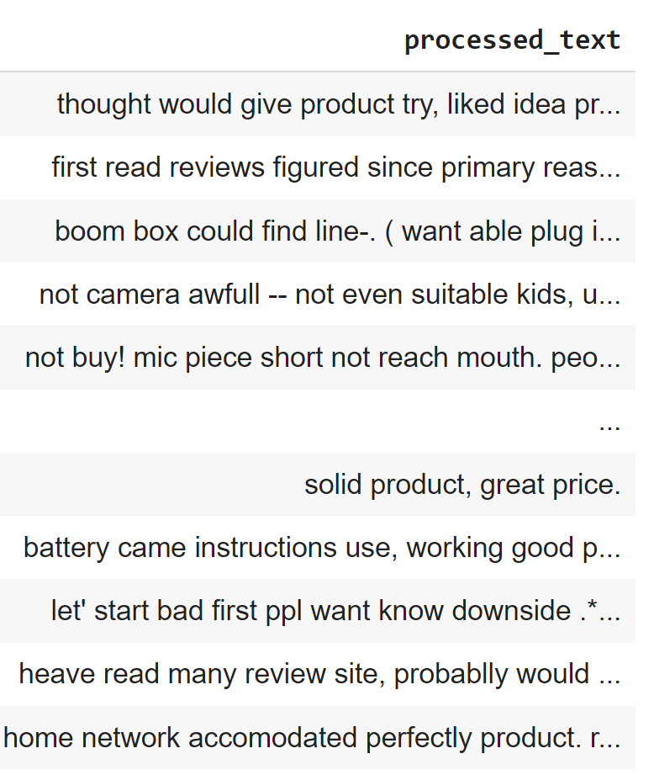
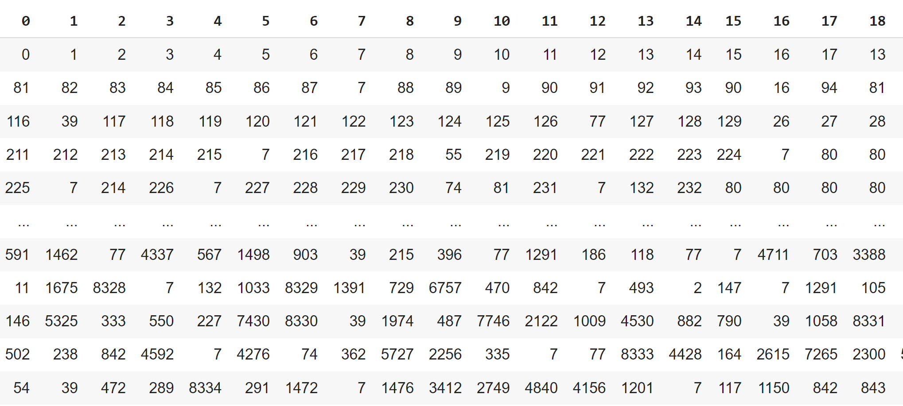
Approach: Word Embeddings + LSTM
Notes:
First, we took the processed text and converted the reviews to word embeddings by encoding each of the words as a number and representing the reviews as sequences of numbers. Then, we applied the word embedding layer in Keras and fed it into an LSTM model.
We actually didn’t continue much further with this approach because we continuously saw that our model was not actually learning and would just predict every review to have the same label. So we instead put some more time into optimizing the other approaches.

Slide 24
SOLUTIONS AND FINDINGS
Insights
Bigram counts were most effective as features
Neutral class less likely to improve more
Solution
A classifier that predicts sentiment on electronics reviews with 70% accuracy
Future Steps
Tune model hyperparameters
Improve the LSTM model
Evaluate performance on other types of text data
Notes:
Conclusion, what we need to do in future? What does this mean to verizon company?
Solution: Again, this is something that Verizon could use on other types of text feedback they receive

Slide 25
Thank you and Q&A

